Slide 1

Maximizing Revenue for Taxi Cab Drivers through Payment Type Analysis
by Tarun Kale

Slide 2







Our Journey Today
Problem Statement
Research Question
Data Overview
Understanding the key challenge faced by taxi cab drivers
Identifying how payment types influence revenue
Exploring dataset source, structure, and key variables
Methodology
Analysis & Findings
Hypothesis Testing
Steps followed for data cleaning, analysis, and testing
Insights derived from data visualization and patterns
Statistical validation of assumptions
Recommendations
Data-driven suggestions for maximizing revenue

Slide 3
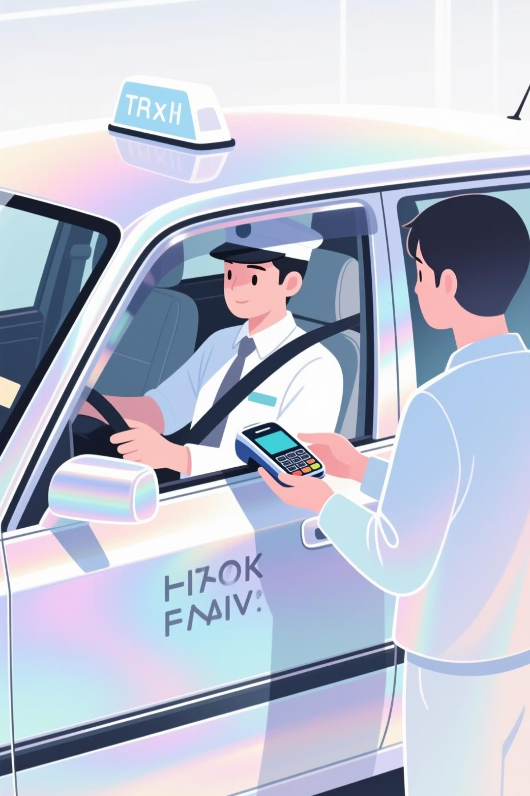
The Challenge We're Solving
Problem Statement
Objective
In the fast-paced taxi booking industry, maximizing revenue is key to long-term success and driver satisfaction. This project leverages data-driven insights to identify whether payment methods influence fare pricing and overall revenue.
To conduct an A/B hypothesis test analyzing the relationship between total fare and payment type. Using Python statistical methods and descriptive analytics, we aim to discover if certain payment methods lead to higher average fares.
Research Question
Is there a significant relationship between total fare amount and payment type? Can drivers encourage customers toward payment methods that yield higher revenue, without affecting customer experience?

Slide 4
Data Overview
For this analysis, we utilized the NYC Taxi Trip Records dataset, containing over 500,000 rows and 18 columns of trip-level information. Through data cleaning and feature engineering, we filtered the dataset to include only the columns directly impacting our study — the relationship between payment type and fare amount.
Feature Name
Description
passenger_count
Number of passengers in a trip (1–5)
payment_type
Mode of payment (Card or Cash)
fare_amount
Total fare charged for the trip
trip_distance
Distance of the trip in miles
duration
Trip duration in minutes

Slide 5



Our Analytical Approach
A structured analytical process was followed to understand the relationship between payment type and fare amount, using both descriptive and statistical techniques.
Descriptive Analysis
Hypothesis Testing
Correlation Analysis
Performed statistical analysis to summarize key aspects of the dataset, focusing on fare amounts, payment types, and trip characteristics.
Conducted a T-test to evaluate whether different payment methods significantly influence fare amounts.
Measured the strength and direction of the relationship between trip duration and fare amount, identifying how strongly fare increases with longer trip durations.

Slide 6

Data Cleaning & Feature Engineering
Data Cleaning Process
Feature Engineering
Initial Dataset: ~500,000 rows, 18 columns
Identifying Key Features Affecting Fare Amount:
Used value_counts to verify 0% missing values in key columns
Trip Distance (miles) – Directly influences total fare
Removed duplicate records to maintain unique trip entries
Trip Duration (minutes) – Created new time-based feature to capture duration impact
Dropped irrelevant columns not affecting fare or payment type
Final Dataset: 406,511 rows and 5 key columns
Creating 'Duration' Feature:
Validated dataset using distribution-based checks instead of only counting nulls — ensuring accurate and clean data.
duration = tpep_dropoff_datetime - tpep_pickup_datetime
Converted both columns from object → datetime. Computed duration in minutes for better comparability.

Slide 7
Journey Insights: Payment Types Matter
To explore whether payment type (Card vs Cash) influences key ride metrics like Fare Amount, Trip Distance, and Trip Duration.
Metric
Card (Mean ± SD)
Cash (Mean ± SD)
Observation
Fare Amount ($)
10.14 ± 4.43
9.82 ± 4.49
Card users have slightly higher fares, indicating higher-value trips
Trip Distance (miles)
2.19 ± 1.42
2.06 ± 1.46
Card payments are linked with longer trips
Trip Duration (minutes)
11.28 ± 5.92
10.96 ± 6.01
Longer-duration trips tend to be paid via card

Slide 8
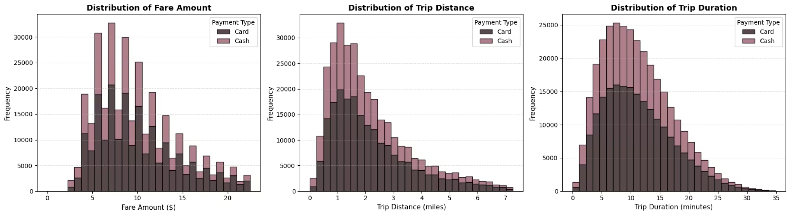
Key Interpretation
Customers using cards prefer longer and higher-fare rides, likely due to convenience and safety of digital payments. Cash users typically make shorter and low-fare trips. This indicates that encouraging card transactions can lead to more stable and higher revenues for drivers.

Slide 9
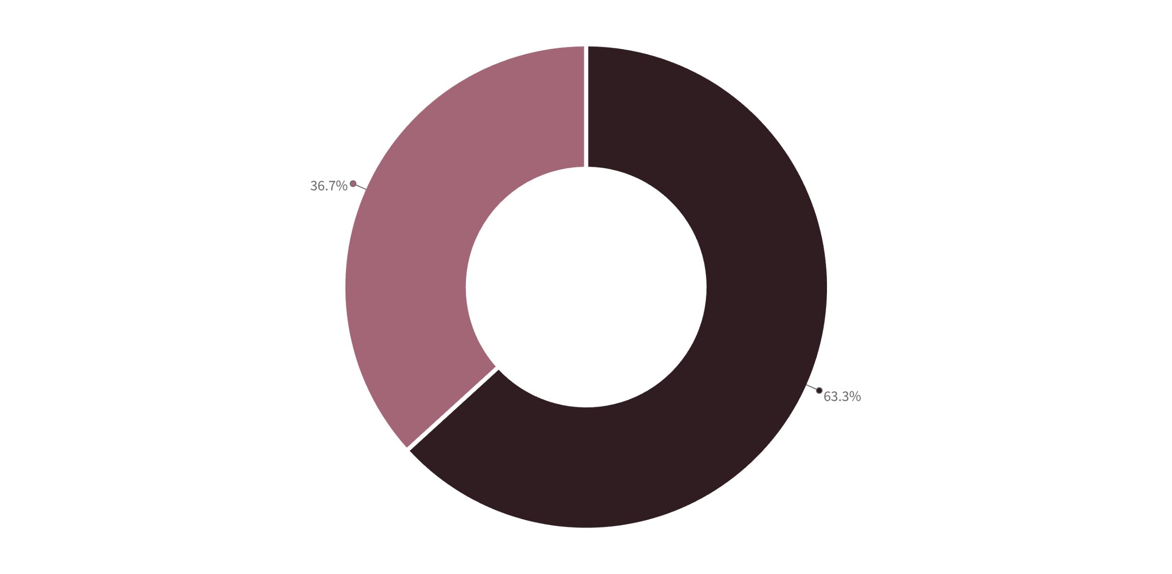

Payment Type Preferences
To visualize which payment method customers prefer the most, we analyzed the distribution of payment types across all trips.
Card
Cash
Key Insight: Most customers prefer to pay by card (63.3%), while cash payments (36.7%) are less frequent — indicating a strong trend toward digital and cashless transactions in the taxi industry.

Slide 10
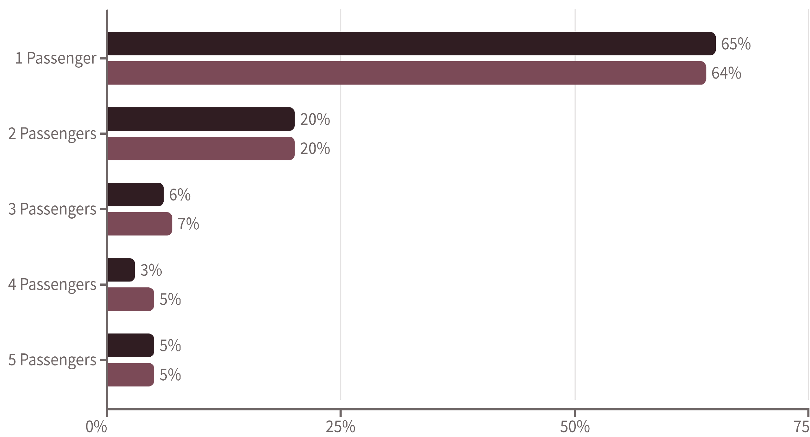
Passenger Count Analysis
To explore how the number of passengers in a ride influences the payment method and understand the distribution of trips across different passenger counts.
Card (%)
Cash (%)
Solo Riders Dominate
Group Rides Are Less Common
Strategic Implications
Card payments are dominated by solo passengers (65%), showing that individuals prefer card-based payments for convenience. Cash transactions also mostly come from single-passenger rides (64%).
As passenger count increases, the proportion of trips drops sharply, indicating that larger groups are less likely to use taxis or may split fares differently. Across both payment types, 2–3 passenger rides make up ~25% of total trips.
Solo riders form the core revenue base for both card and cash transactions. Digital payment incentives can be targeted toward individual and small-group riders. Taxi companies could offer group ride discounts to attract multi-passenger trips.

Slide 11

Hypothesis Testing Results
To test whether the average fare amount differs between customers paying by card vs cash, and to analyze the relationship between fare amount and trip duration.
Fare Amount vs Payment Type
Fare Amount vs Duration
Null Hypothesis (H₀): There is no significant difference in the average fare between customers who use credit cards and those who pay cash.
0.906
Alternative Hypothesis (H₁): There is a significant difference in the average fare between credit card and cash-paying customers.
Correlation Coefficient
Test Used: Independent T-Test
Very close to +1, showing a strong positive correlation
Metric
Value
As trip duration increases, the fare amount also increases linearly. In simple words: "The longer the trip, the higher the fare."
T-statistic
19.53
p-value
7.00 × 10⁻⁸⁵
Key Insight: Customers using credit cards tend to have higher average fares, implying they likely take longer or higher-value trips. This suggests that promoting card payments can increase driver revenue. Both payment method and duration are critical revenue factors.
Alpha (α)
0.05
Decision: Reject H₀ → There is a significant difference in average fares between card and cash users.

Slide 12
Data-Driven Strategy to Boost Revenue
Our analysis revealed that payment type and trip duration both have a strong influence on total fare — directly impacting driver revenue.
Payment Type Impact
Trip Duration Correlation
Customers paying by card generate higher average fares compared to cash users. Digital payment adoption aligns with higher-value or longer trips. Promoting cashless rides can help increase total revenue per trip.
A strong positive correlation (r = 0.906) between trip duration and fare amount confirms: "The longer the trip, the higher the fare." Fare structure is time-dependent and predictable, guiding pricing optimization.
2
Key Insights
Card payments = Higher fares. Longer trips = More earnings.
"Encouraging digital payments and optimizing longer route pricing can significantly boost overall revenue efficiency."
Combining both insights provides a data-driven strategy to improve driver income and enhance revenue forecasting for taxi operators.

Slide 13

Thank You

